Slide 1
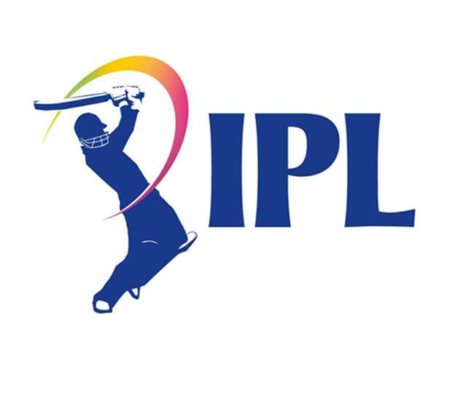
PERFORMANCE OF MUMBAI IN
1
2
12
3
11
4
10
5
9
Team : Impact Facts
Himanshu Pandey
Nilesh Pandey
Shivam Mishra
6
8
7

Slide 2




METHODOLOGY
We have Taken Secondary Data from Kaggle

Slide 3

OBJECTIVES
To Forecast how many match will happen in $2023$.
To study the performance of Mumbai in IPL from $13$ years.
Association between the toss winning and toss decision in IPL

Slide 4
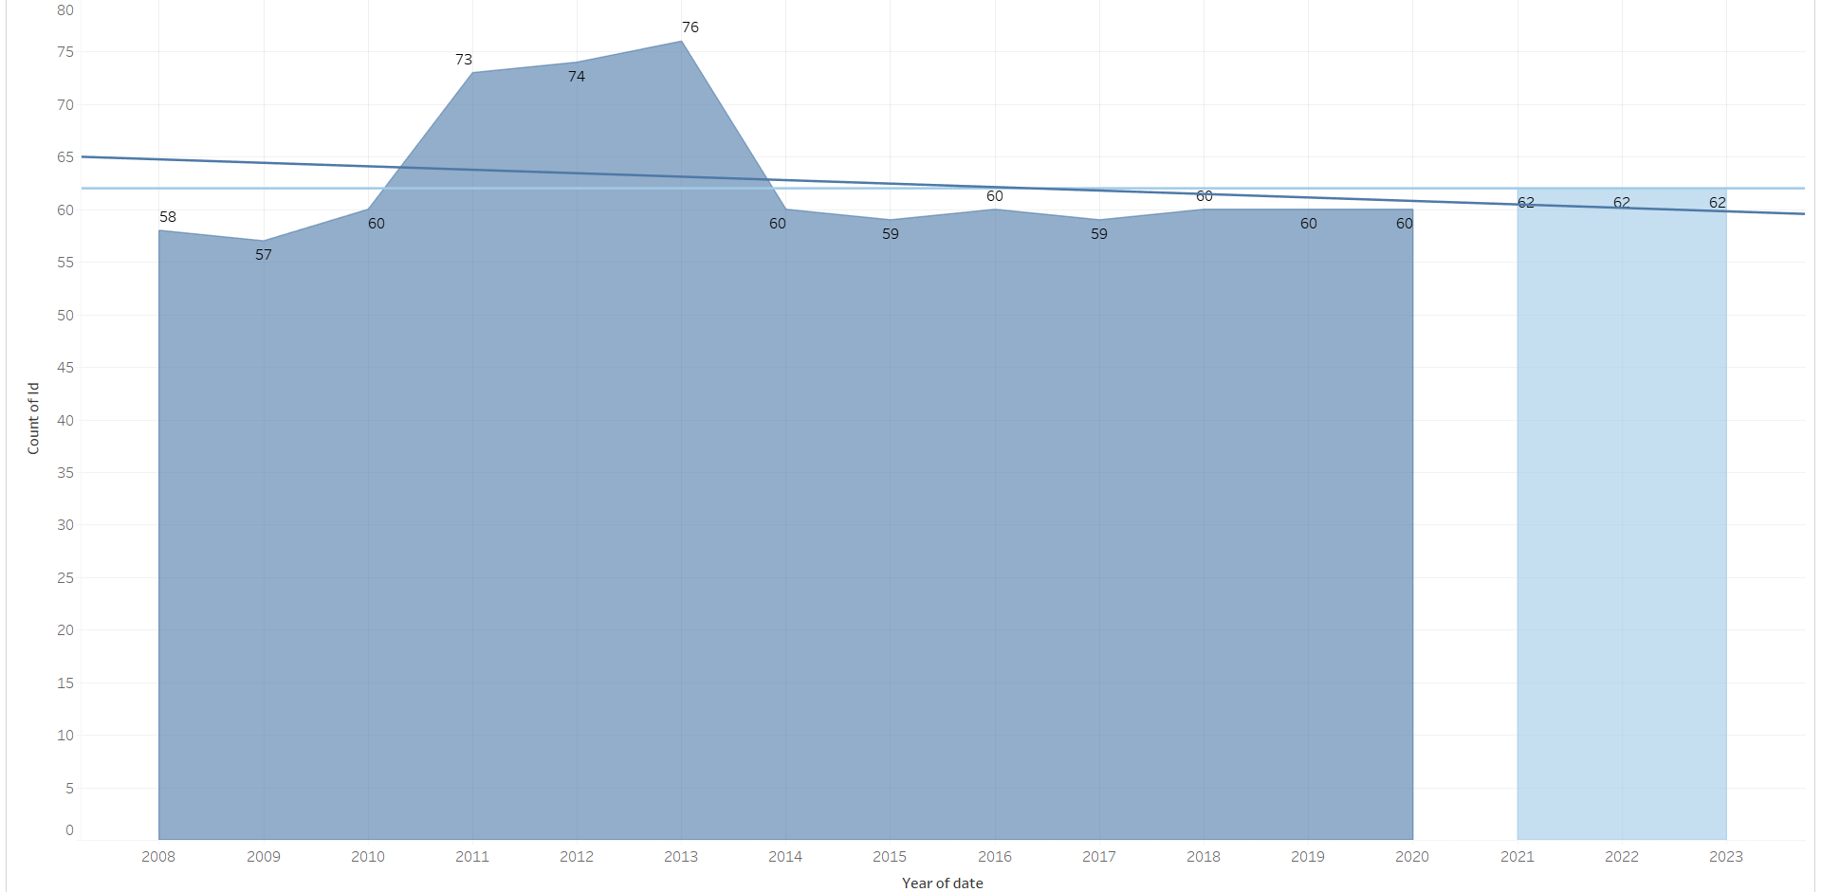
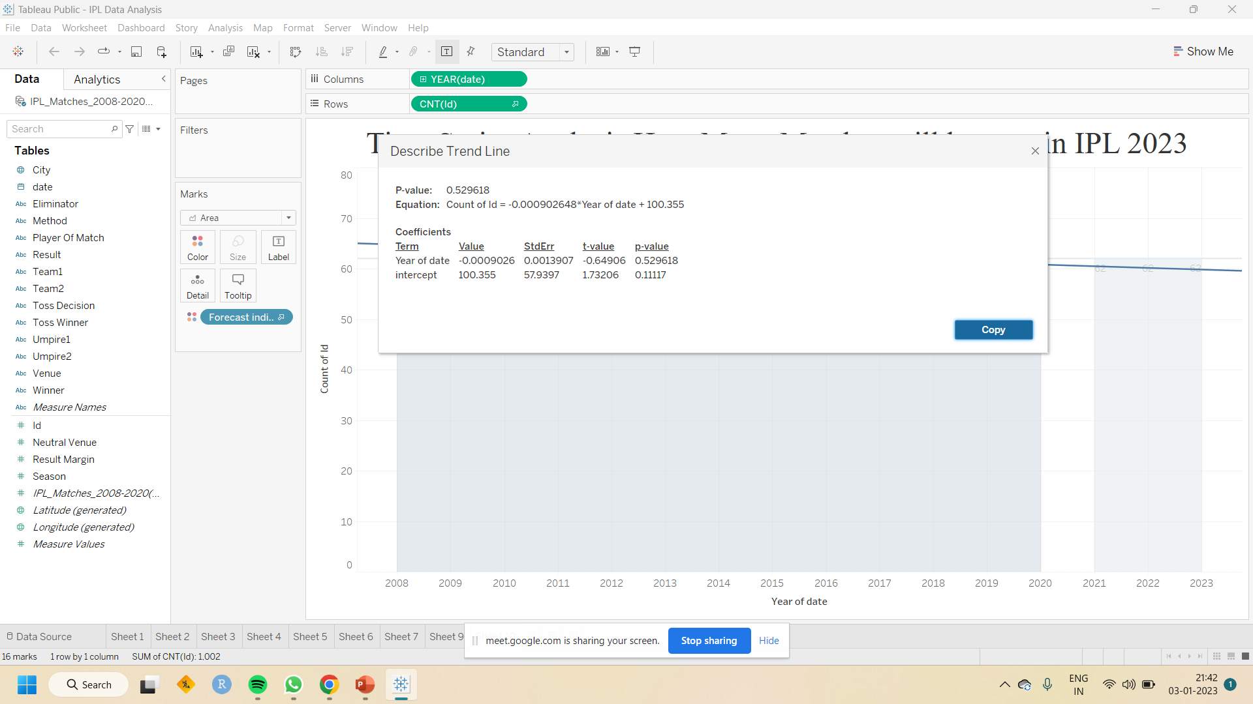
Time Series Analysis

Slide 5
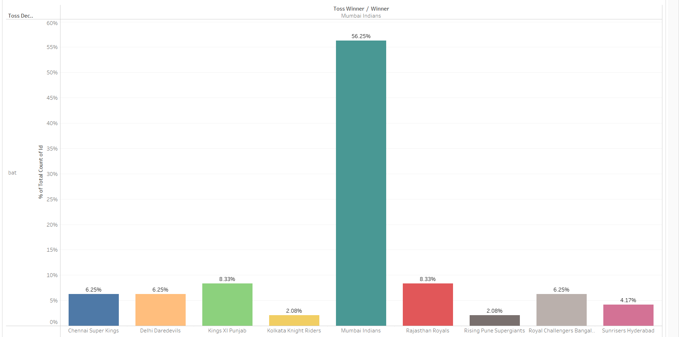
MI winning toss won match with bat

Slide 6
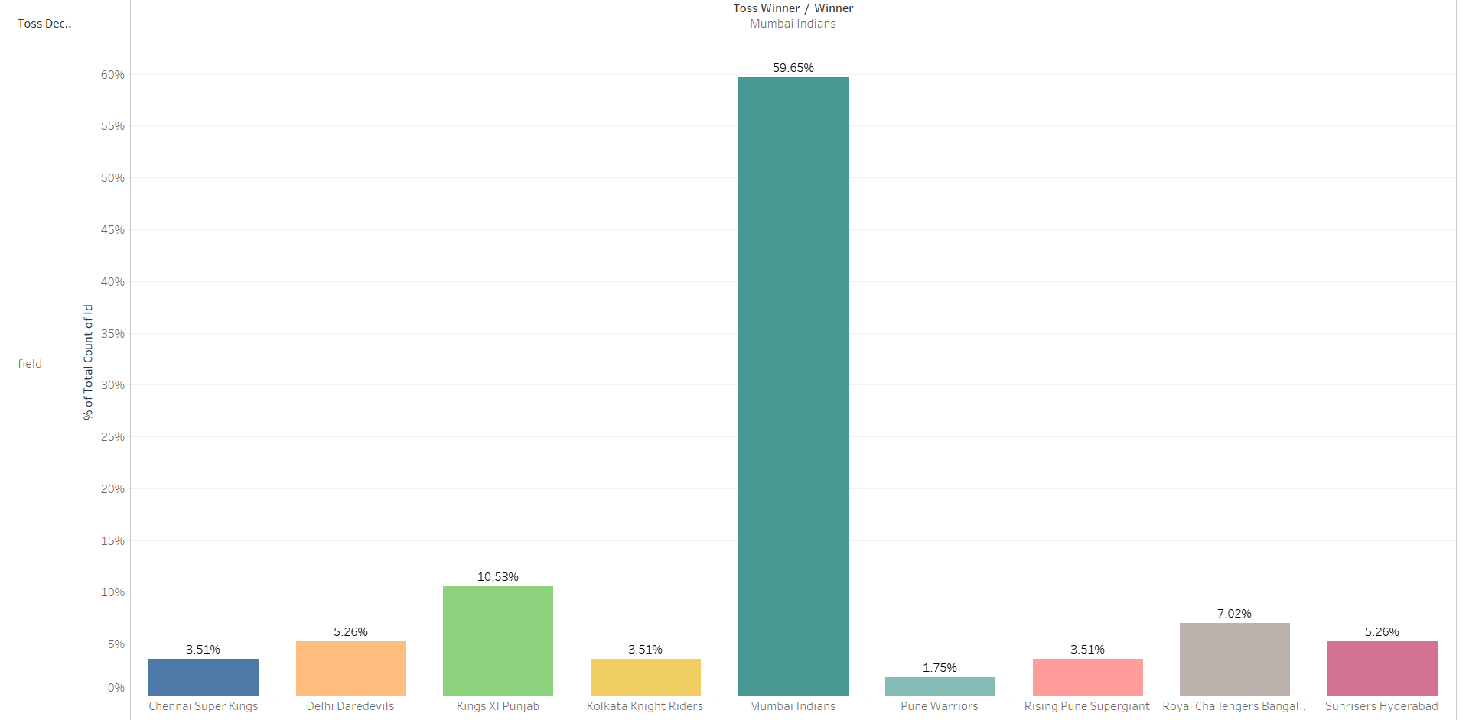
MI winning toss won match with field

Slide 7
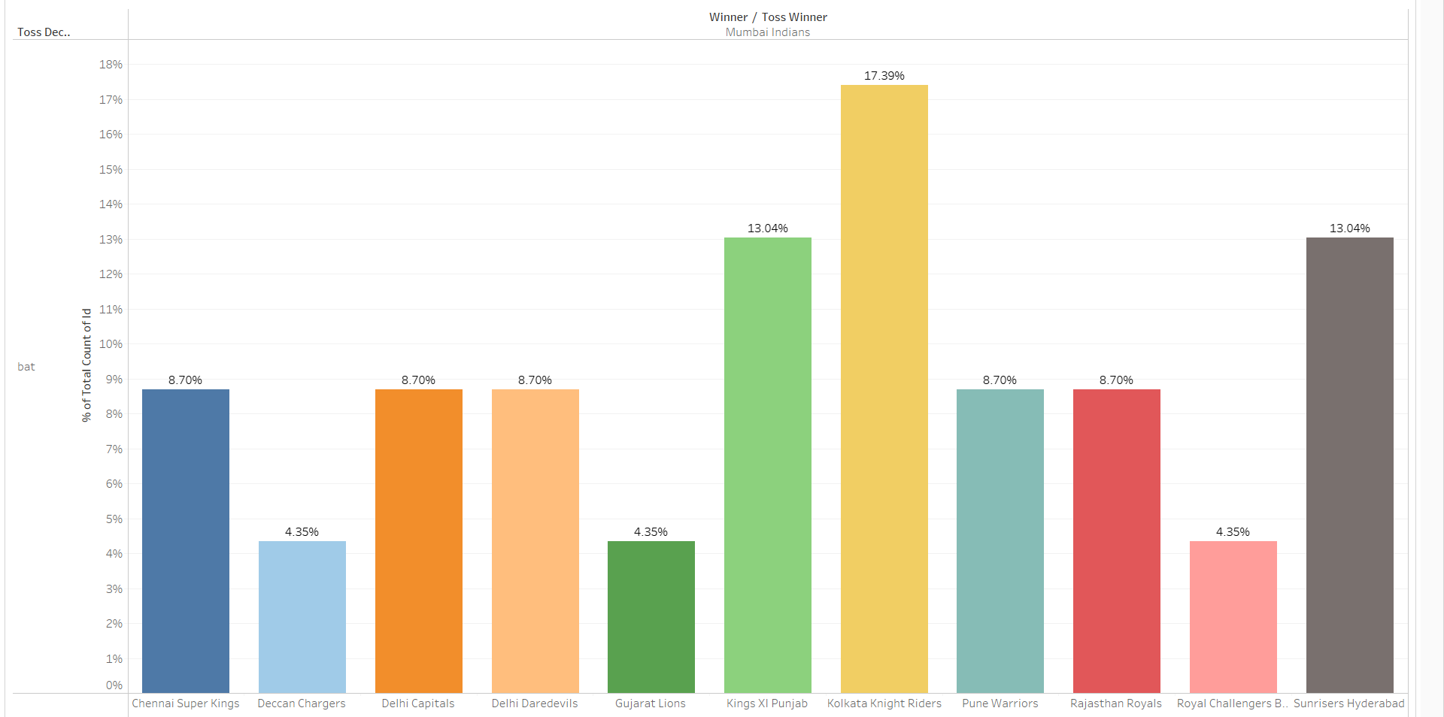
MI losing toss won match opponent choose bat

Slide 8
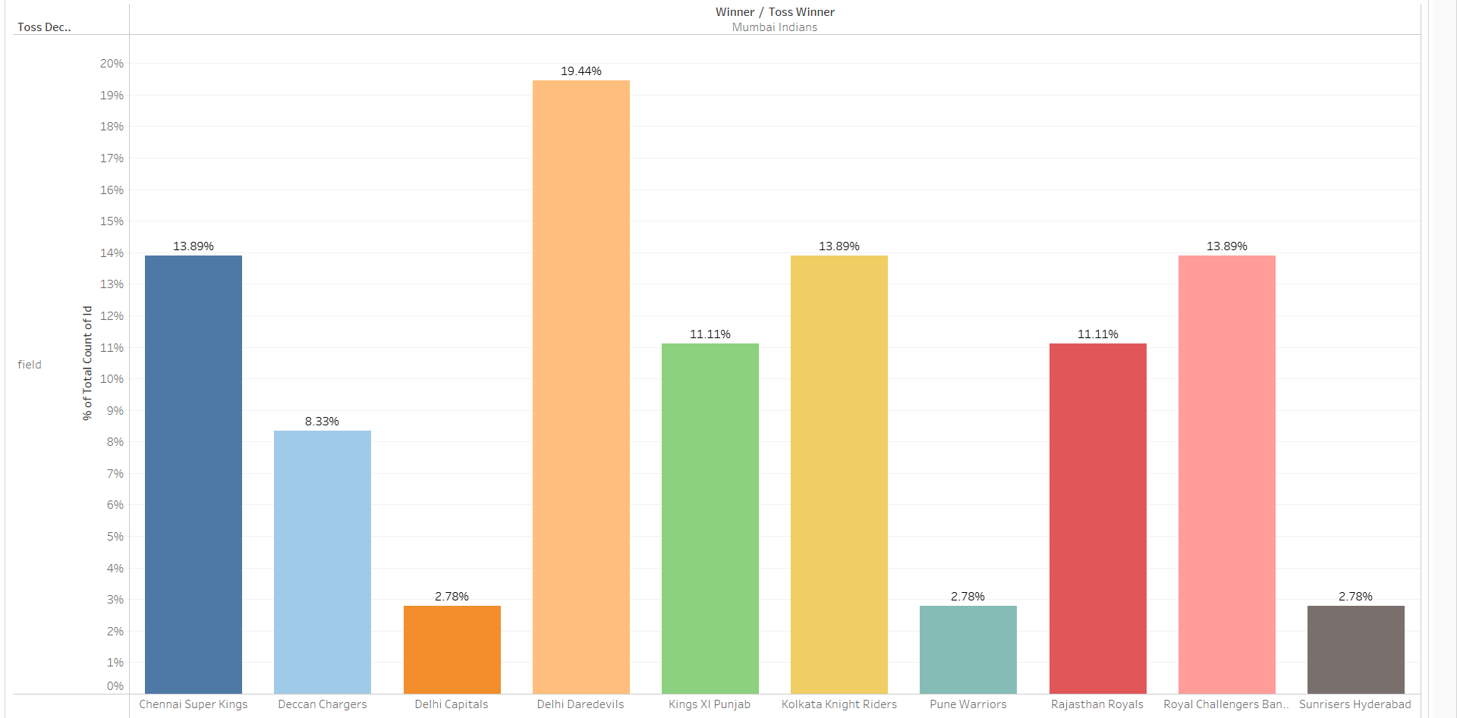
MI losing toss won match opponent choose field

Slide 9
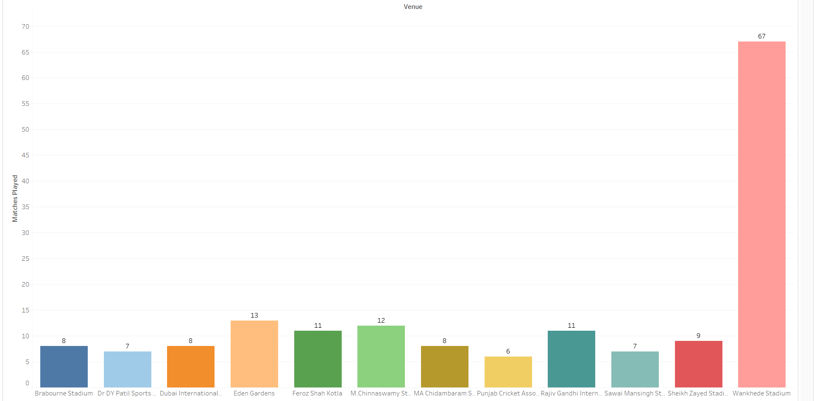
MI matches in popular stadium

Slide 10
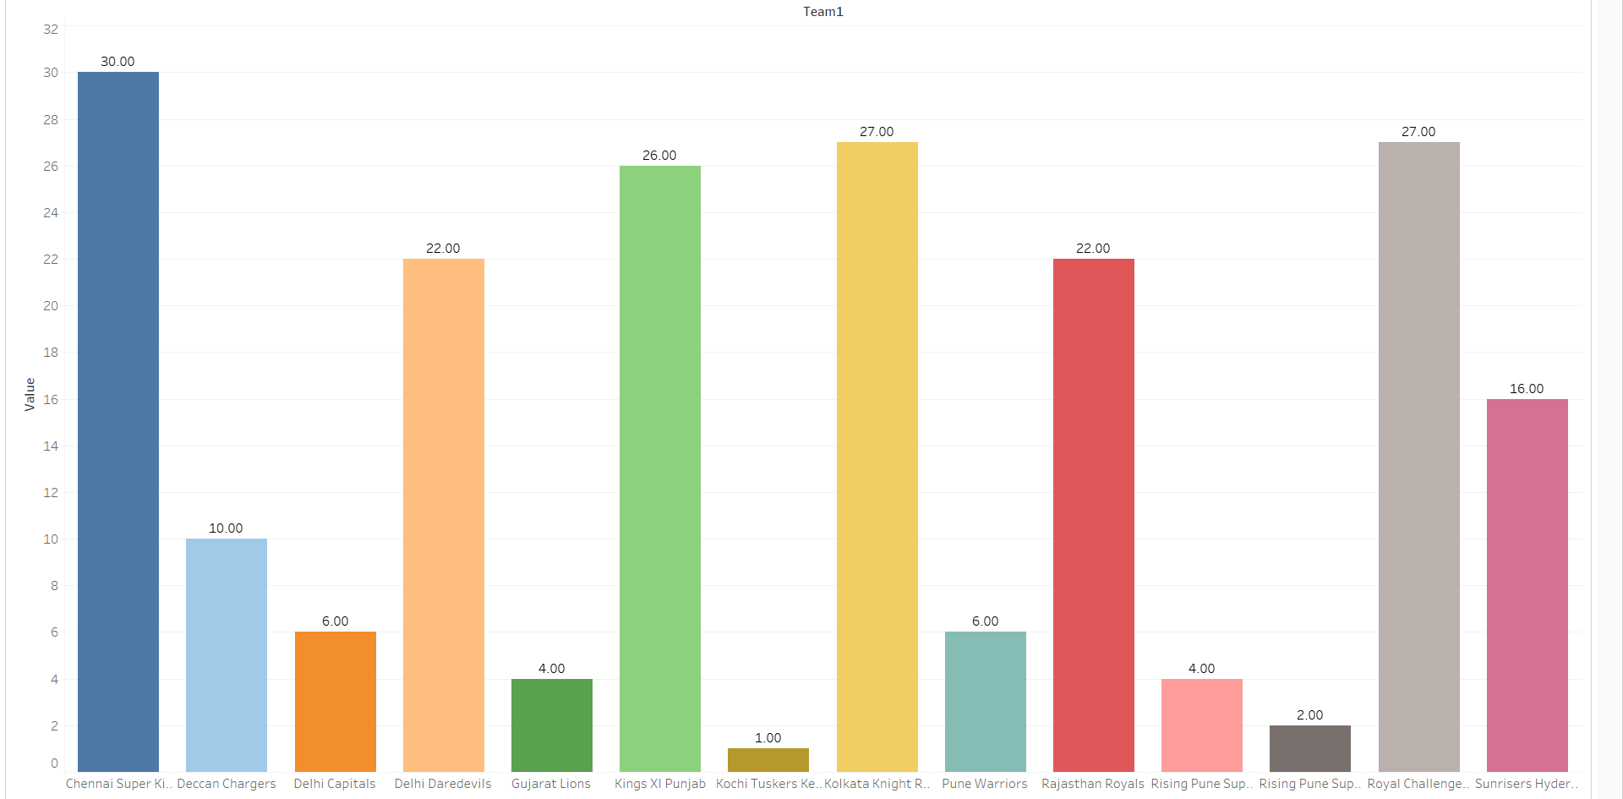
MI matches against other teams

Slide 11
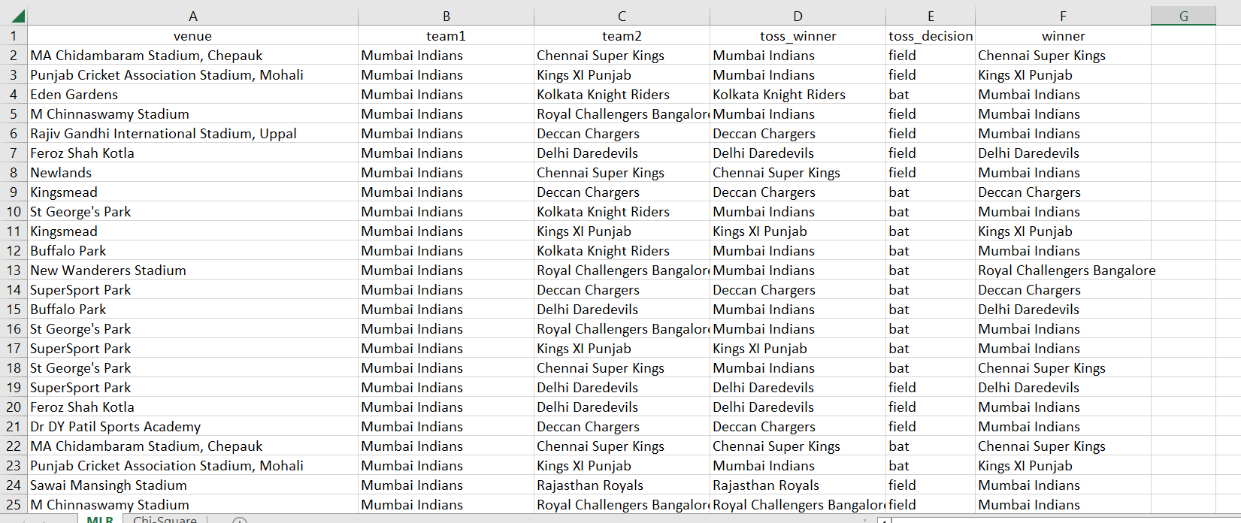
Data for Chi-Square Test

Slide 12
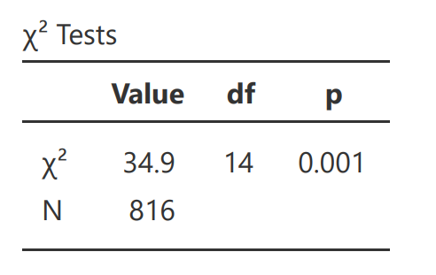
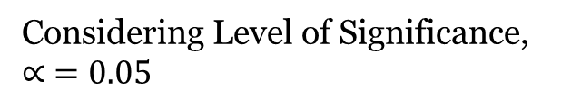
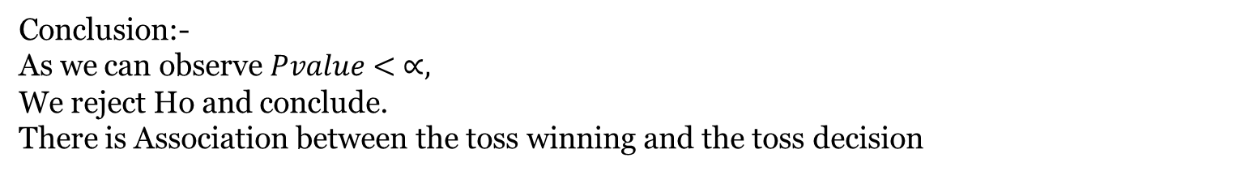
CHI SQUARE TEST
Ho :- There is no association between the toss winning and the toss decision
vs
H1 :- There is association between the toss winning and the toss decision
Considering Level of Significance,
$$∝ =0.05$$
Conclusion:-
As we can observe $Pvalue< ∝,$
We reject Ho and conclude.
There is Association between the toss winning and the toss decision

Slide 13
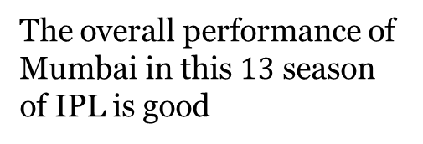
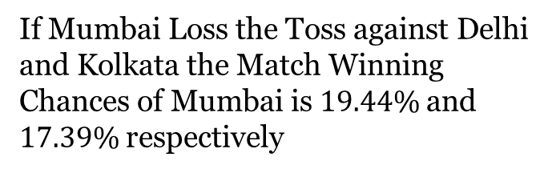
CONCLUSION
The overall performance of Mumbai in this $13$ season of IPL is good
If Mumbai Loss the Toss against Delhi and Kolkata the Match Winning Chances of Mumbai is $19.44\%$and $17.39\%$ respectively
Mumbai Will Win Match by Taking decision as Bat and Field is $56.25$% and $59.65\%$respectively

Slide 14
REFERENCE
The jamovi project (2022). jamovi. (Version 2.3) [Computer Software]. Retrieved from https://www.jamovi.org.
https://www.kaggle.com/datasets/patrickb1912/ipl-complete-dataset-20082020
R Core Team (2021). R: A Language and environment for statistical computing. (Version 4.1) [Computer software]. Retrieved from https://cran.r-project.org. (R packages retrieved from MRAN snapshot 2022-01-01).
https://public.tableau.com/app/profile/shivam.mishra2602/viz/IPLDataAnalysis_16718918378380/

